Slide 1
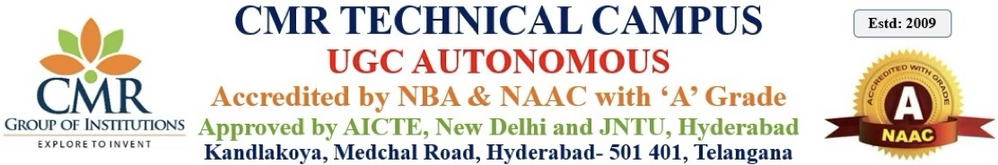
DEPARTMENT OF CSE(AI&ML)
Major Project Review 2
Smart Garbage Segregation App
PRESENTED BY:
B.Manohar Reddy (227R1A66D5)
B.Mallikarjun Yadav (227R1A66D7)
Ch.Nikhil Sai (227R1A66E0)
UNDER THE GUIDANCE OF
Dr. S Rao Chintalapudi
(Professor & HOD CSE(AI&ML)

Slide 2
Table Of Contents
Abstract
Introduction
Existing System
Disadvantages
Proposed System
Advantages
System Architecture
Hardware & Software Requirements

Slide 3
Introduction
Improper waste management is a big problem that harms both people’s health and the environment. In many places, waste is still sorted by hand, which takes a lot of time, is not clean, and often goes wrong. To fix this, we created a Smart Garbage Segregation Mobile App that uses artificial intelligence to detect and classify waste. People can just take or upload a photo of their waste, and the app will tell if it’s biodegradable or non-biodegradable. This helps people follow better waste disposal habits, avoid health risks, and protect the environment. The app supports (Good Health and Well-Being) and (Climate Action), making daily life cleaner and more eco-friendly.

Slide 4
Abstract
The Smart Garbage Segregation Mobile App is a simple and helpful tool that uses artificial intelligence to identify waste. Users can take or upload a photo of a waste item, and the app will tell whether it is biodegradable or non-biodegradable. This helps people throw away waste properly without touching or sorting it by hand. It supports good health by reducing contact with harmful waste and also helps protect the environment by promoting better recycling and reducing garbage in landfills. In this way, the app supports both (Good Health and Well-Being(3)) and (Climate Action(13)). It encourages people to be more responsible with their waste. This small step can lead to a cleaner and healthier future for all.

Slide 5
Existing System
In most homes and public places, waste is sorted manually by people or sanitation workers.
Many people don’t know the importance of separating biodegradable, recyclable, and hazardous waste.
Waste is often dumped together, leading to mixing of medical, plastic, and organic waste.
Mixed waste can spread infections, attract pests, and pollute air, water, and soil.It becomes hard to recycle mixed waste, causing loss of useful materials

Slide 6
Disadvantages
Valuable materials (plastic, paper, metal) are lost due to mixing.
Harmful gases like methane are released, causing air pollution.
Hazardous waste endangers workers and nearby communities.
Manual sorting is slow and inefficient.
High costs for large-scale manual waste separation.

Slide 7
Proposed System
AI-based mobile app that classifies waste from images uploaded by users..
Supports biodegradable, recyclable, and poisonous waste classification.
Image preprocessing is automated for better accuracy and ease of use.
Uses lightweight ML models like MobileNet or TensorFlow Lite for fast results.
.

Slide 8
Advantages
High accuracy in classifying different types of waste.
Reduces the need for manual sorting and human error.
Fast waste identification and response time.
Easily accessible via mobile apps.
Educates users about proper waste segregation.

Slide 9
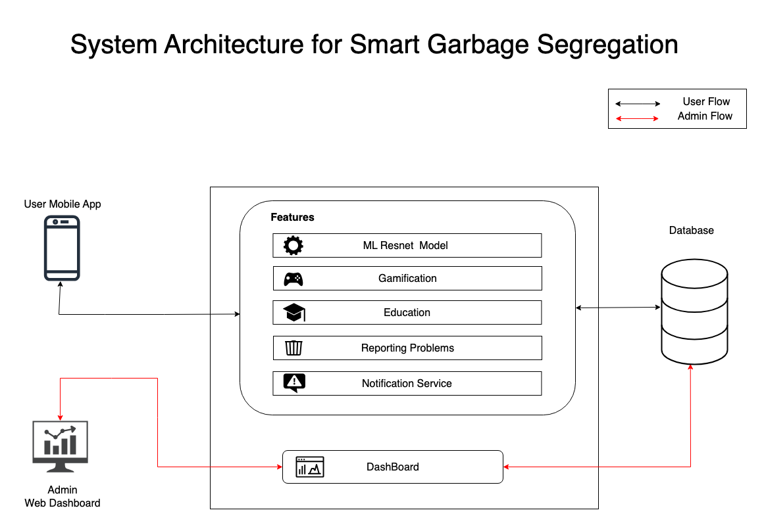

Slide 10
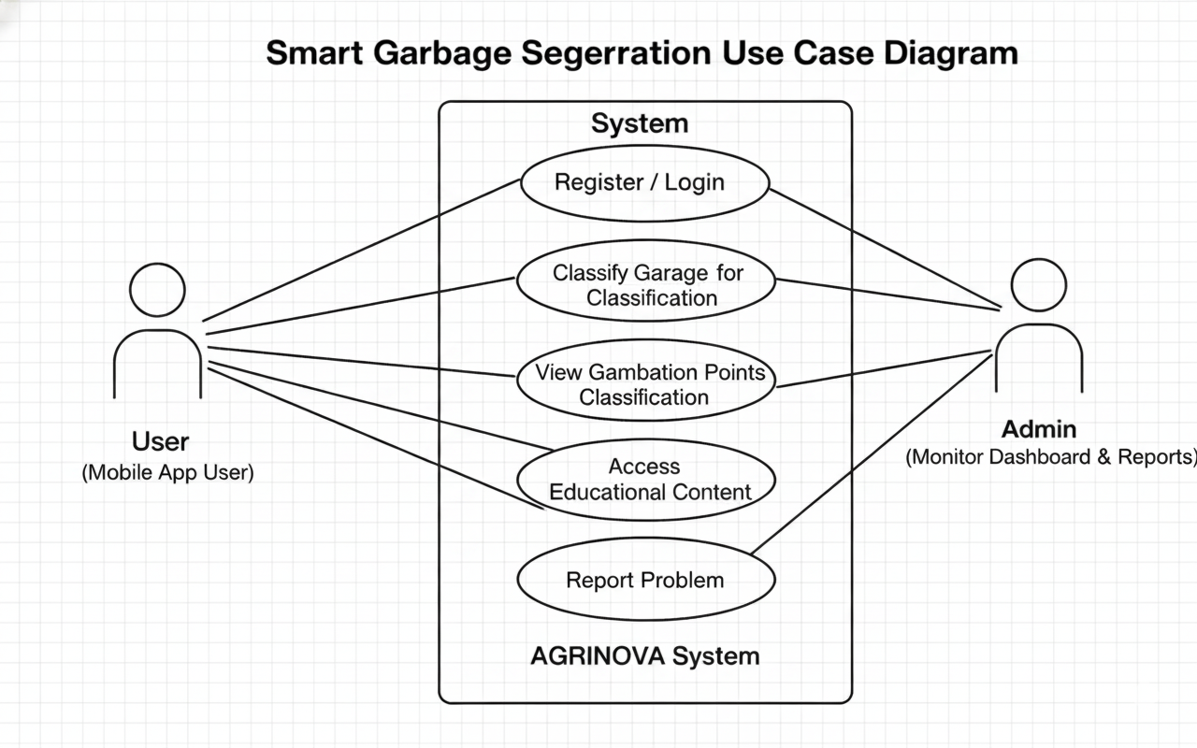
Use Case Diagram

Slide 11
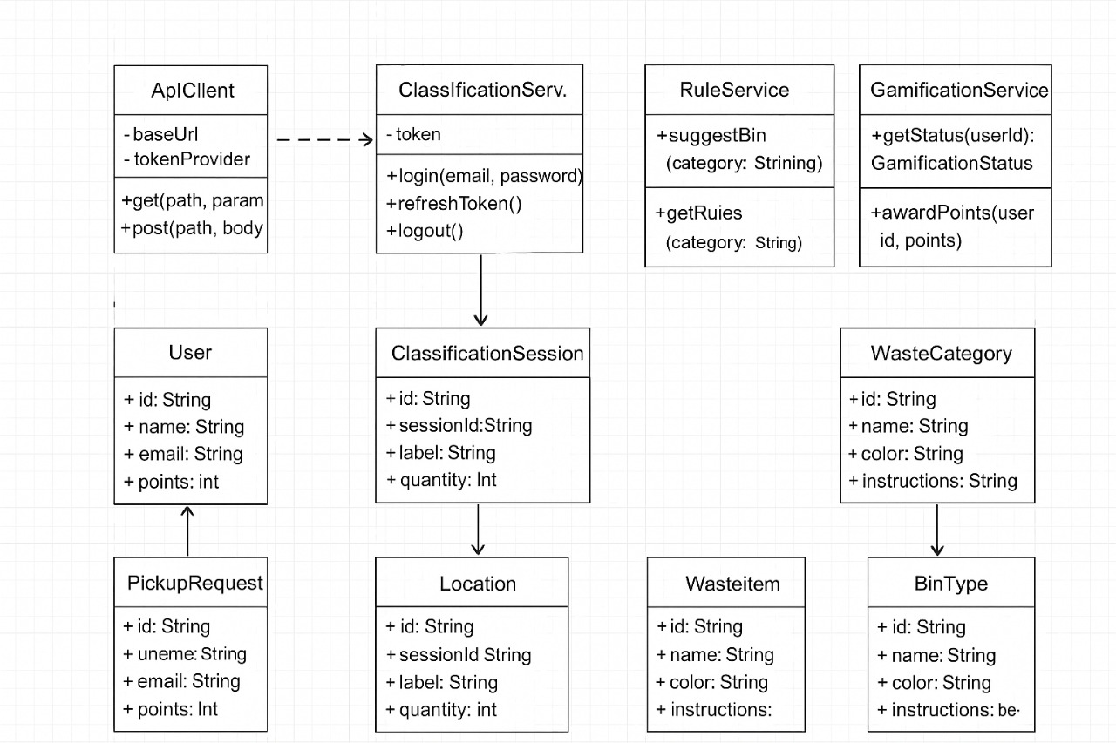
Class Diagram

Slide 12
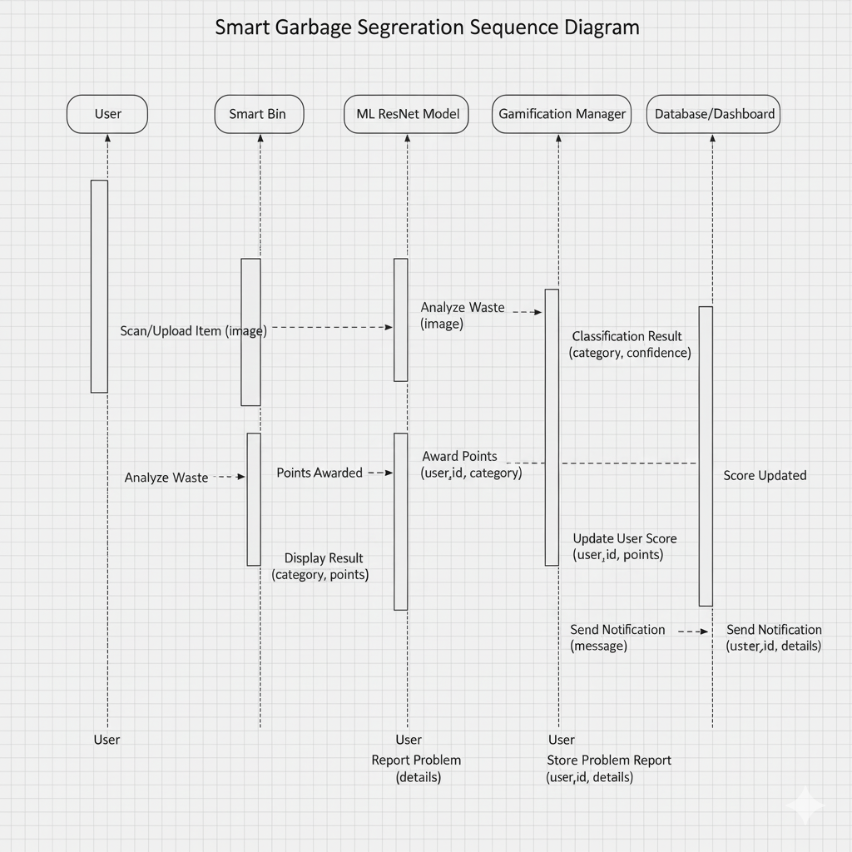
Sequence Diagram

Slide 13
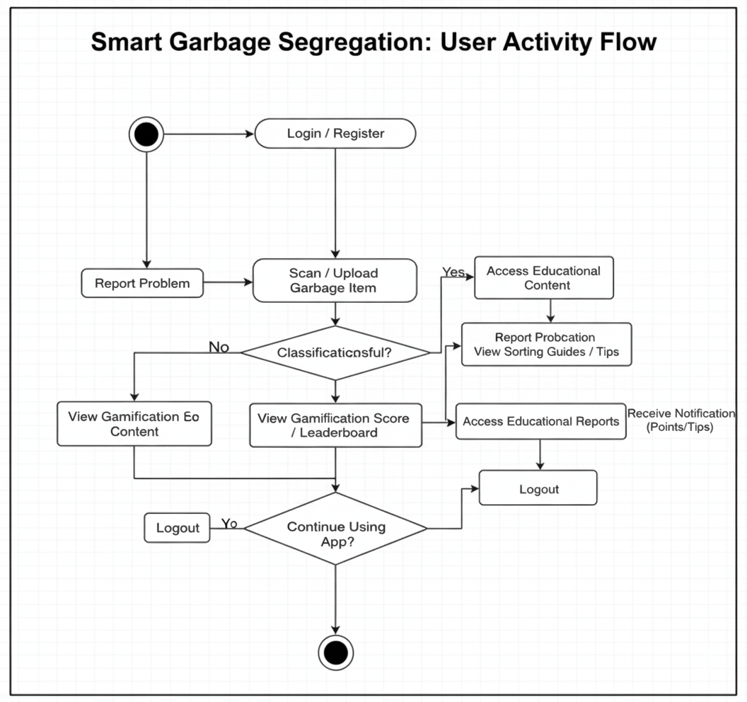
Activity Diagram

Slide 14
Hardware Requirements & Software Requirements
Hardware:
Processor : Intel i7
RAM: 16GB RAM
Storage : 250 GB
Software:
Mobile App: React Native
Backend: Node.js & FastAPI with Python for AI inference
AI Model: ResNet (PyTorch)
Cloud Integration: Cloudinary (for image uploads), Firebase (notifications, authentication)
Database: MongoDB
Dashboard: React js
Notification Service: Firebase Cloud Messaging

Slide 15
THANK YOU

